Slide 1
Fundamentals of deep learning for Multi-GPUs lab 3, part 1: Scaling the batch size

Slide 2
Can we increase the batch size indefinitely?

Slide 3
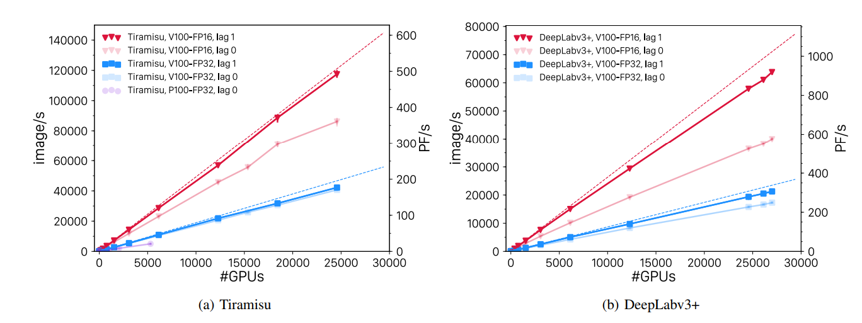
In terms of images / second?
Yes
Kurth, T., Treichler, S., Romero, J., Mudigonda, M., Luehr, N., Phillips, E., ... & Houston, M. (2018, November). Exascale deep learning for climate analytics. In Proceedings of the International Conference for High Performance Computing, Networking, Storage, and Analysis (p. 51). IEEE Press. arXiv:1810.01993
Notes:
We apply optimisation separately layer after a layer.

Slide 4
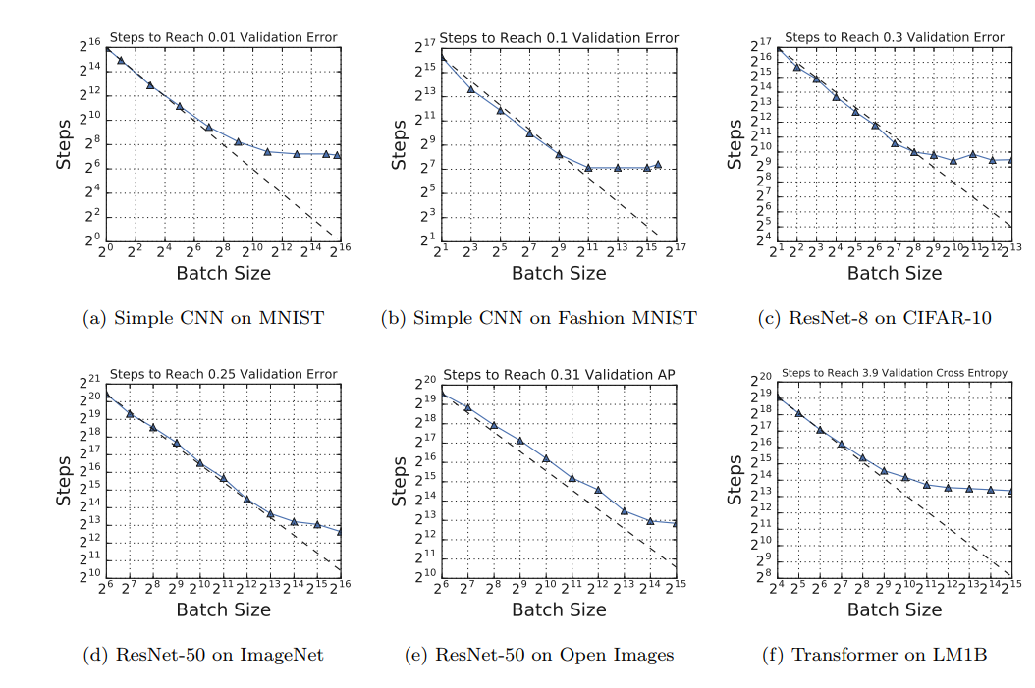
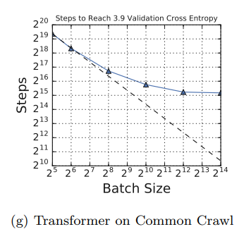
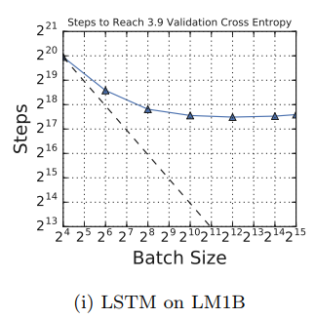
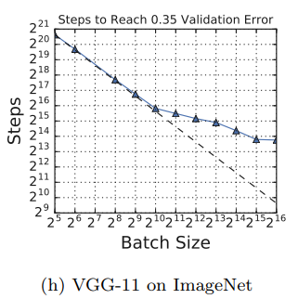
In terms of steps to Convergence?
There are limits
Shallue, C. J., Lee, J., Antognini, J., Sohl-Dickstein, J., Frostig, R., & Dahl, G. E. (2018). Measuring the effects of data parallelism on neural network training. arXiv:1811.03600

Slide 5
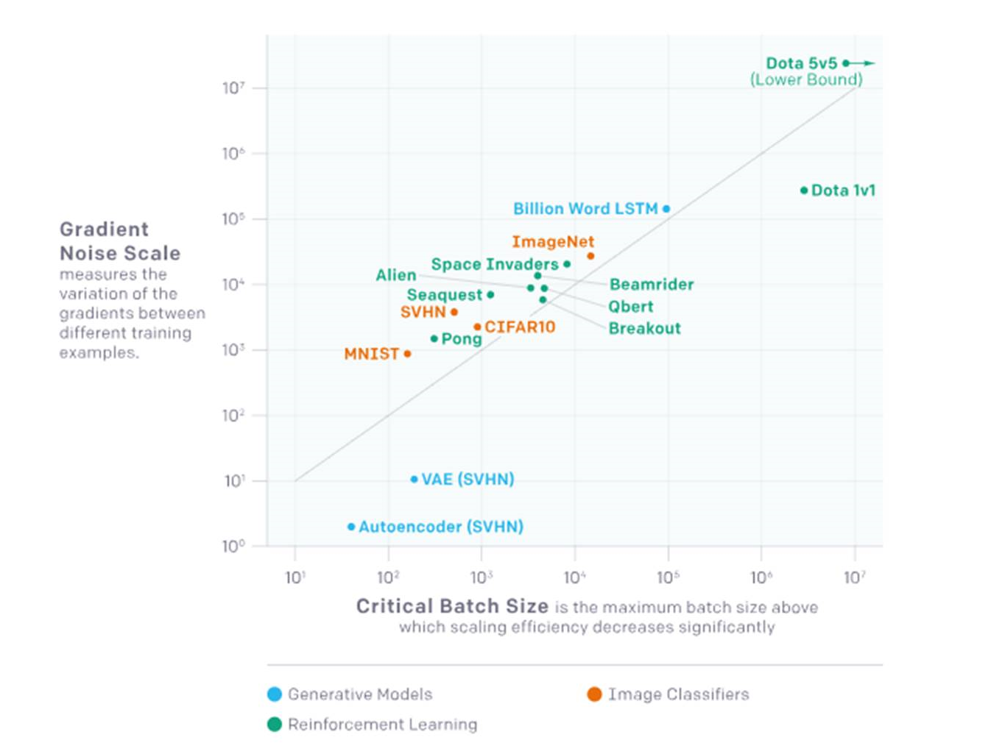
In terms of steps to Convergence?
There are limits
https://blog.openai.com/science-of-ai/
Notes:
We apply optimisation separately layer after a layer.

Slide 6
Large Minibatch and its Impact on Accuracy

Slide 7
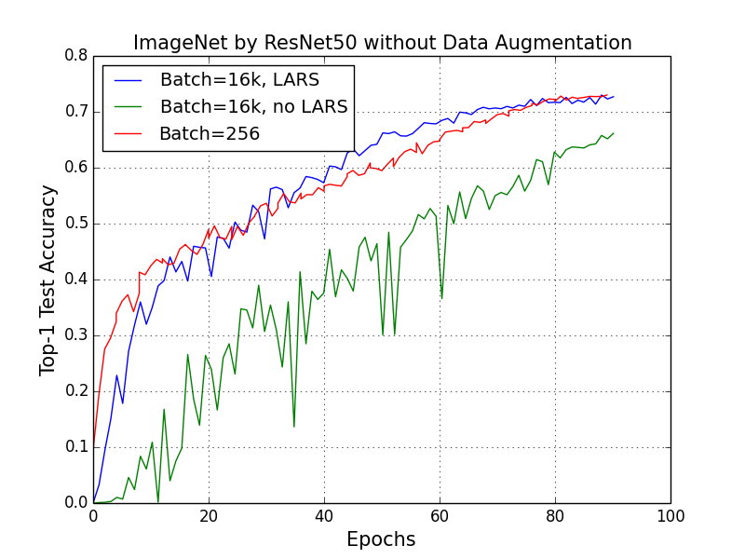
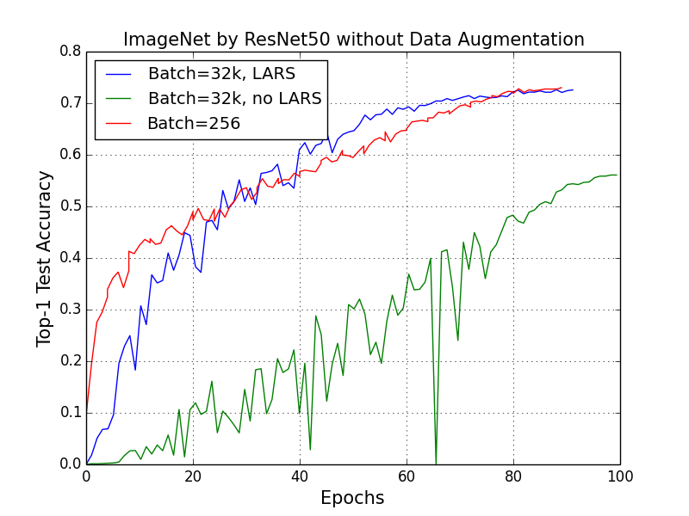
Impact on Accuracy
Naïve approaches lead to degraded accuracy
You, Y., Zhang, Z., Hsieh, C., Demmel, J., & Keutzer, K. (2017). ImageNet training in minutes. arXiv: 1709.05011

Slide 8
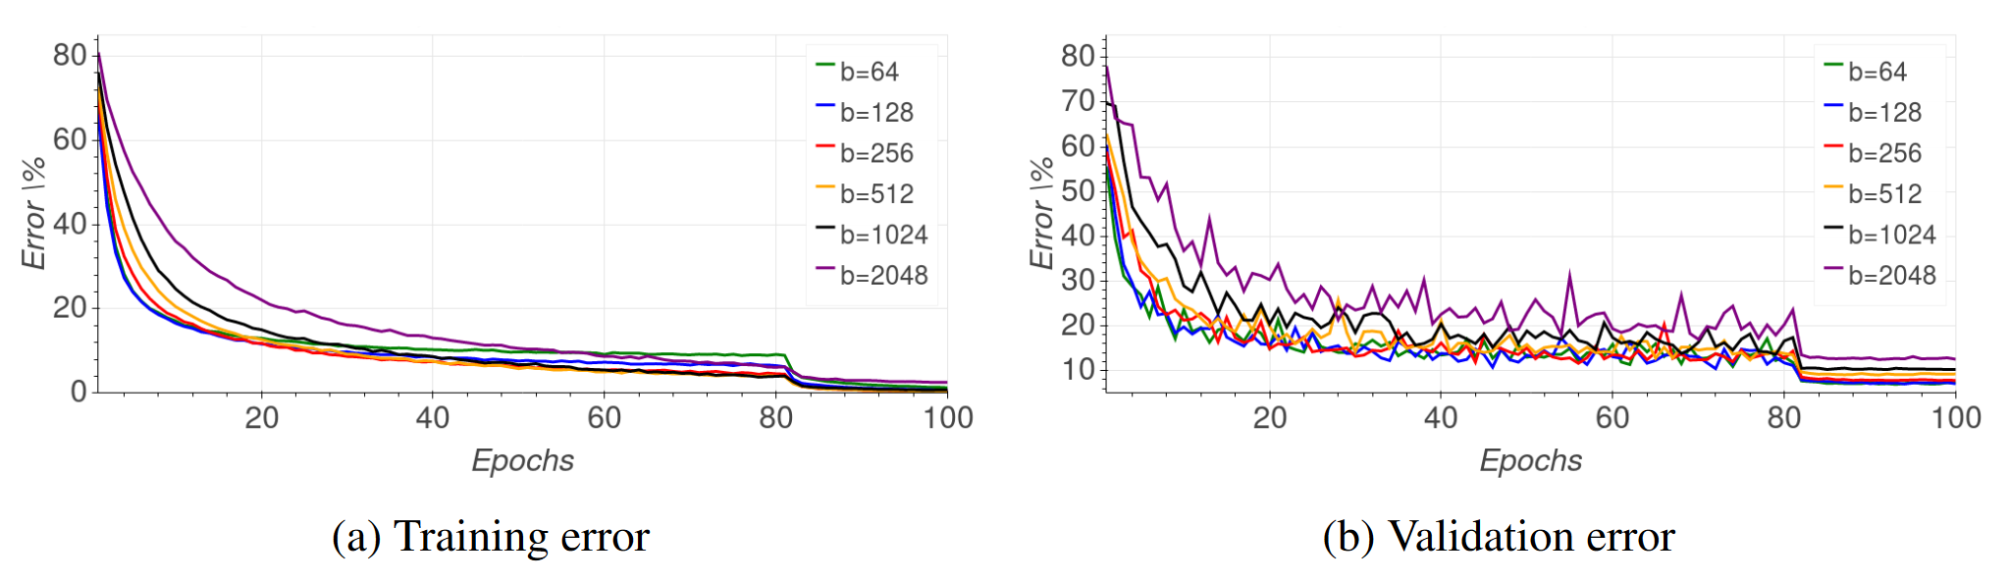
Impact on Accuracy
Naïve approaches lead to degraded accuracy
Hoffer, E., Hubara, I., & Soudry, D. (2017). Train longer, generalize better: closing the generalization gap in large batch training of neural networks. arXiv:1705.08741

Slide 9
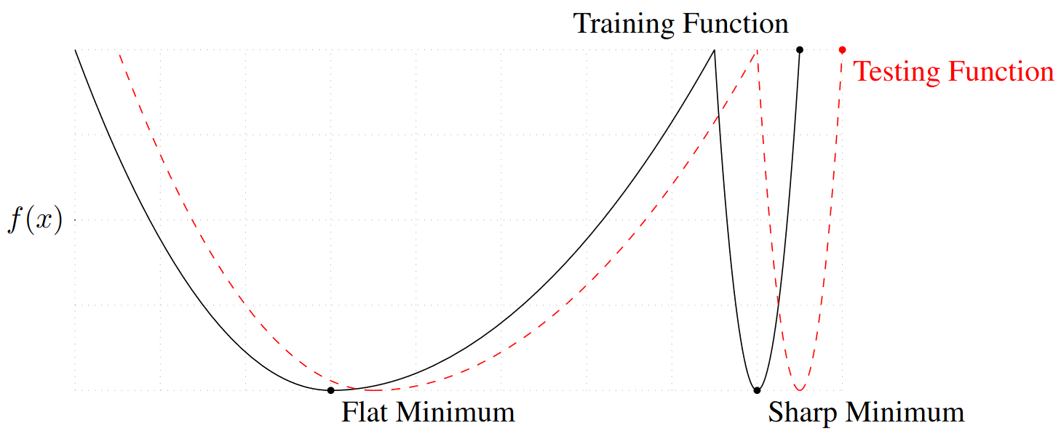
Impact on Accuracy
Why? Generalization and flatness of minima?
Keskar, N. S., et al. (2016). On large-batch training for deep learning: Generalization gap and sharp minima. arXiv:1609.04836
Notes:
We can see as the minibatch increases the minima found are sharper and sharper.
This makes an intuitive sense flatter minima are much less sensitive to variability in data.
We are just approximating the true loss function.

Slide 10
Impact on Accuracy
Why does it happen? Noise in the gradient update.
Keskar, N. S., et al. (2016). On large-batch training for deep learning: Generalization gap and sharp minima. arXiv:1609.04836

Slide 11
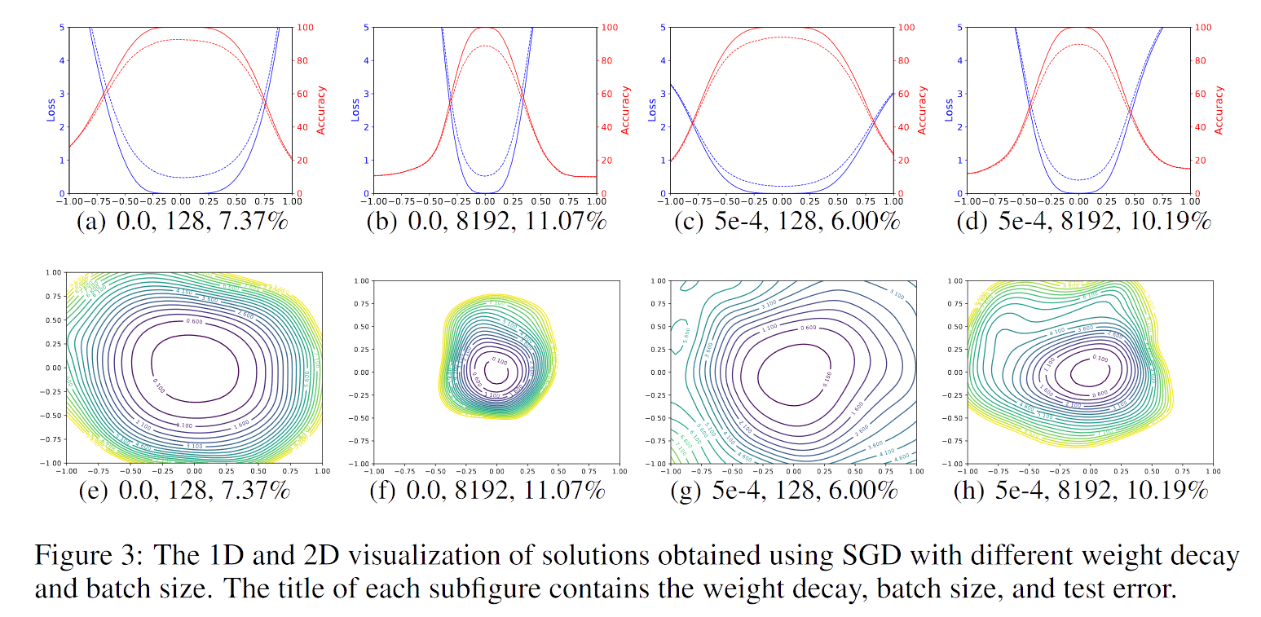
Impact on Accuracy
Why? Generalisation and Flatness of minima?
Li, H., Xu, Z., Taylor, G., & Goldstein, T. (2017). Visualizing the Loss Landscape of Neural Nets. arXiv:1712.09913
Notes:
We can see as the minibatch increases the minima found are sharper and sharper.
This makes an intuitive sense flatter minima are much less sensitive to variability in data

